Slide 1
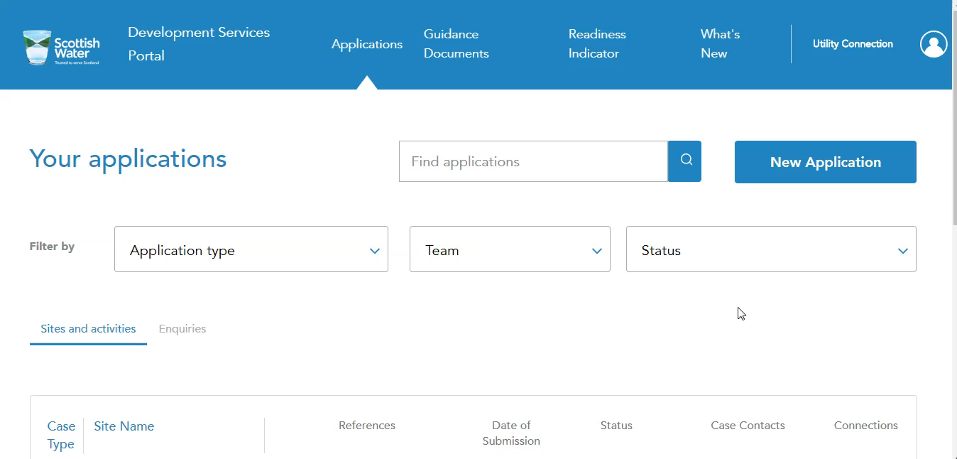
Difference between Admin and Member – More Detail

Slide 2
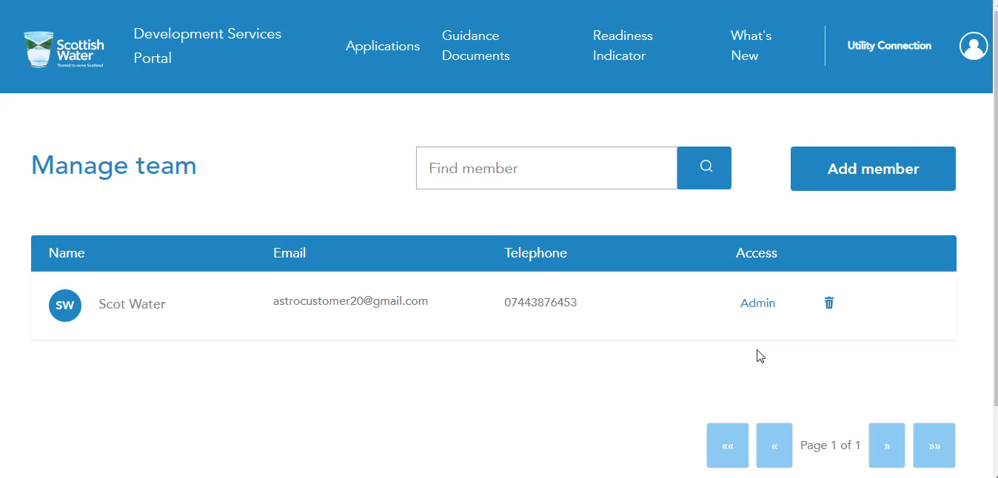
Case Manager and End Customer – more detail

