Slide 1
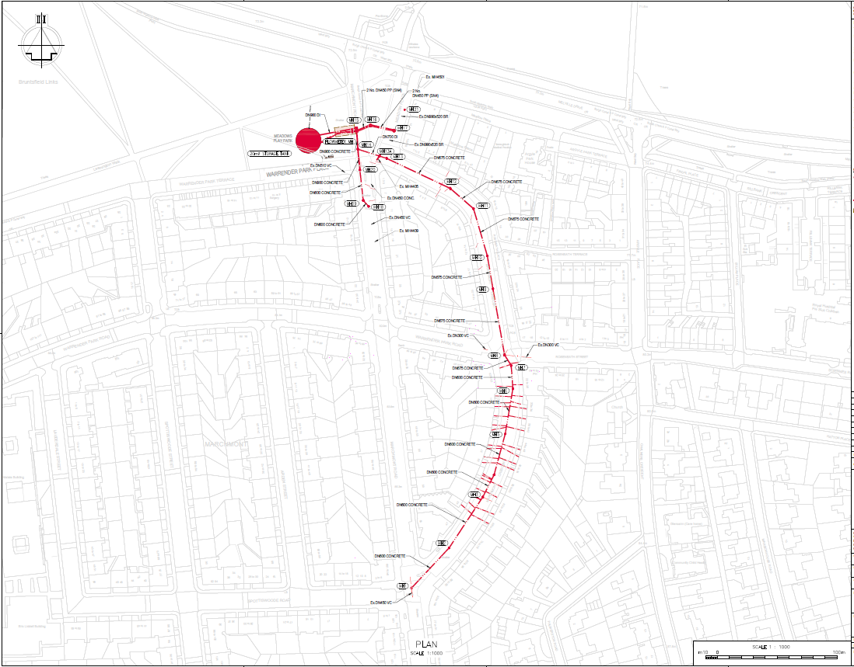
Phase 1
Shaft construction completed
(Area to remain site compound until project completion)
Phase 8 – Completed
Phase 2 – Completed
Phase 3 – Completed
Phase 8b – Current phase –expected completion 5 July 2024
Phase 4 – Completed
Phase 4a – Completed
Phase 5 – To start 8th July 2024*
Phase 9 – To start Nov/Dec 2024*
Phase 6 – To start Aug/Sept 2024*
Phase 7 – To start Oct/Nov 2024*
* = All dates are approximate and subject to change depending on work progress and weather

